Slide 1
Assignment 2 – Comp Sys & Networking
Shane Fitzpatrick
20091385

Slide 2
Sections
Project idea
Graphical representation
Components
Resources
Algorithm Logic

Slide 3
Project idea
Control
Control front porch lights using skills gained from my course
Use
Use a Raspberry Pi
Use Philips hue lights & sensors
Use Blynk mobile IOT application
Pi
Pi to control the lights based on certain conditions
Operate outside of daylight hours
Turn on based on motion sensor activity
Turn on based on GPS location

Slide 4
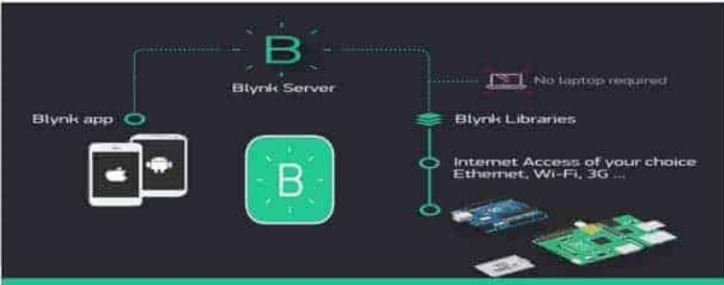

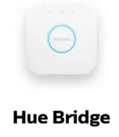
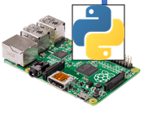
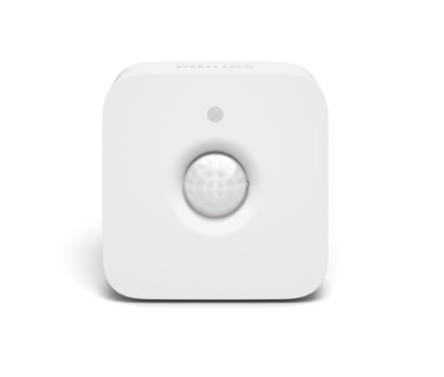
Graphical representation
Hue Sensor

Slide 5
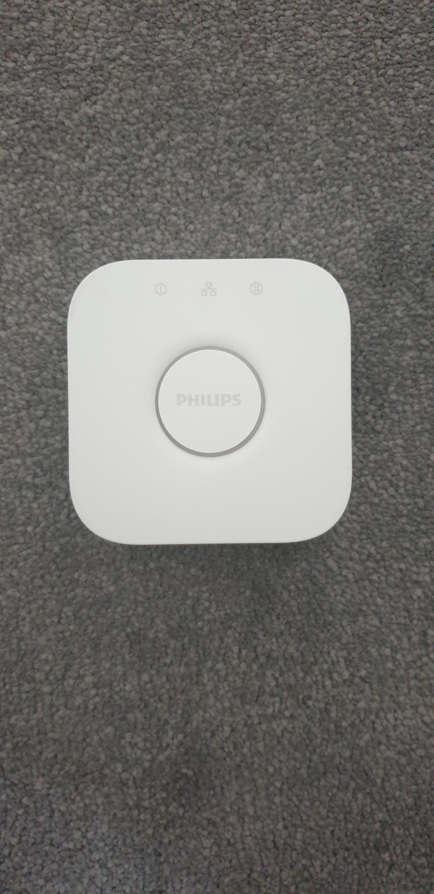
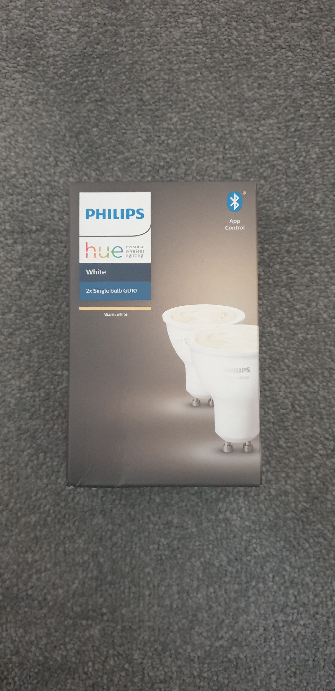
Components
Philips Hue Lights
Philips Hue Bridge

Slide 6
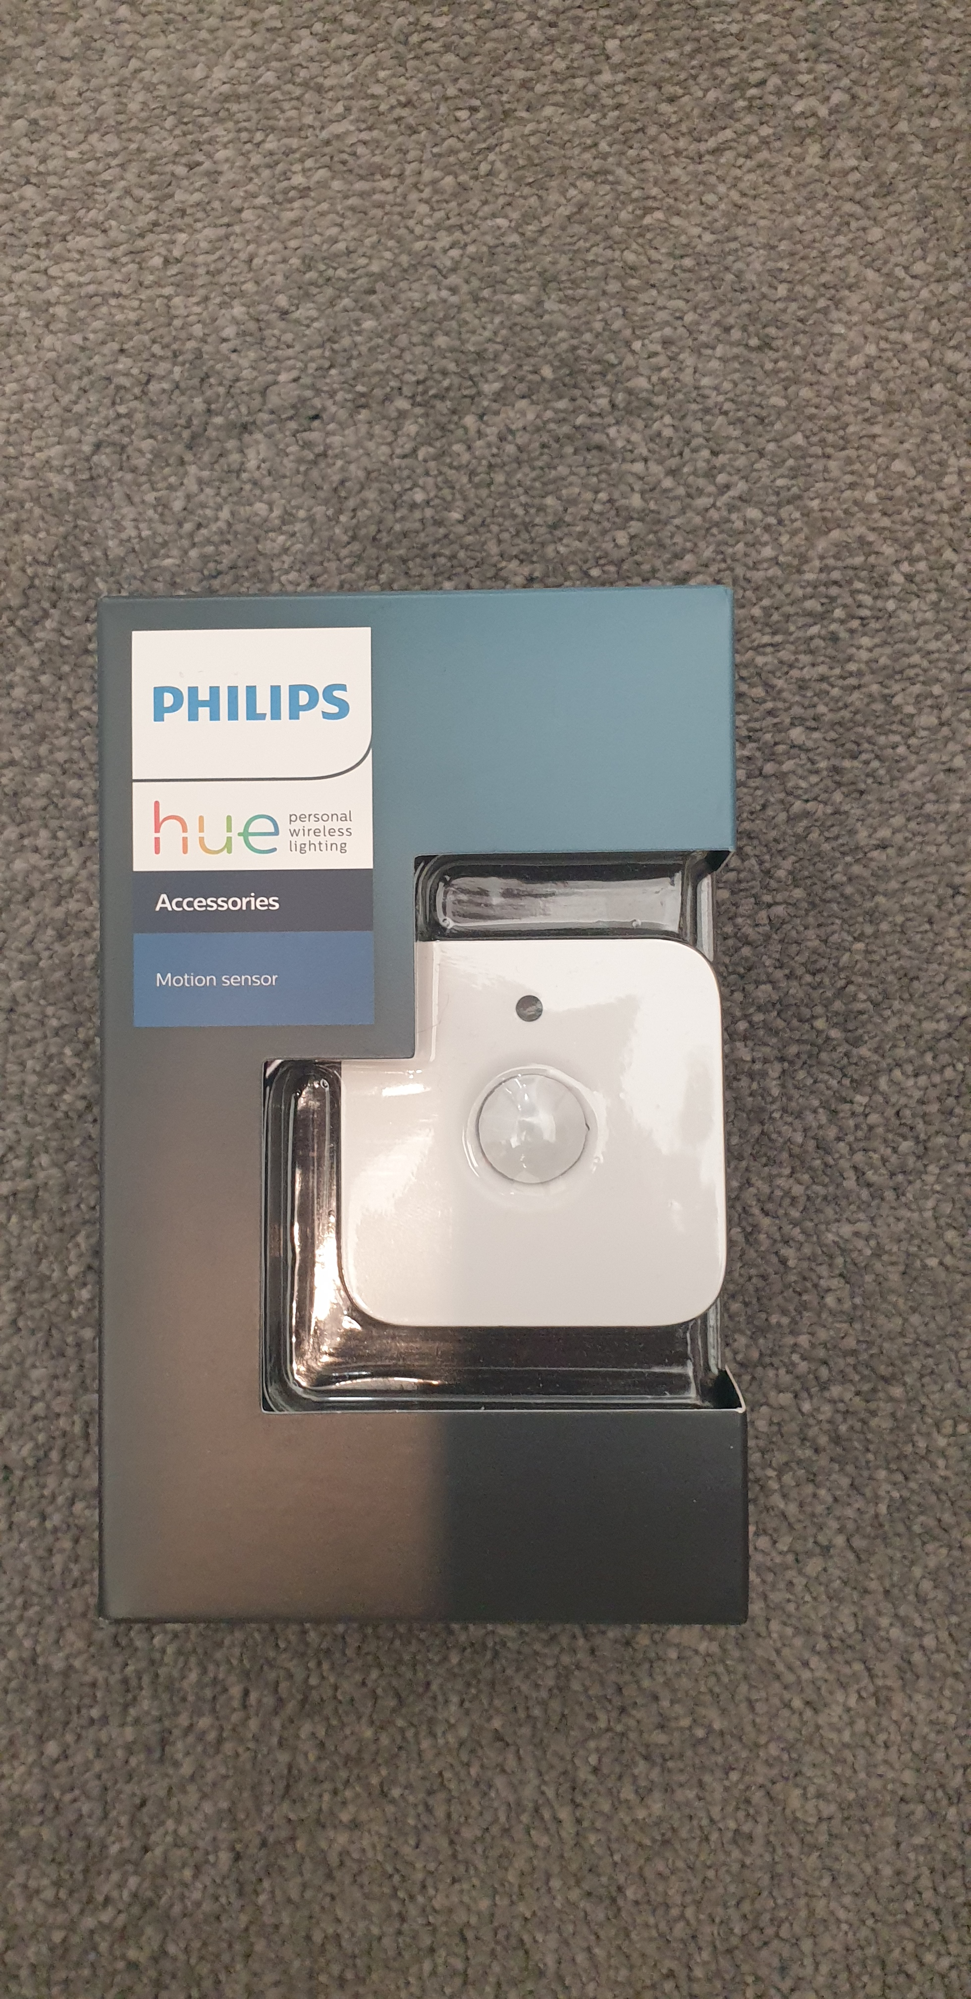
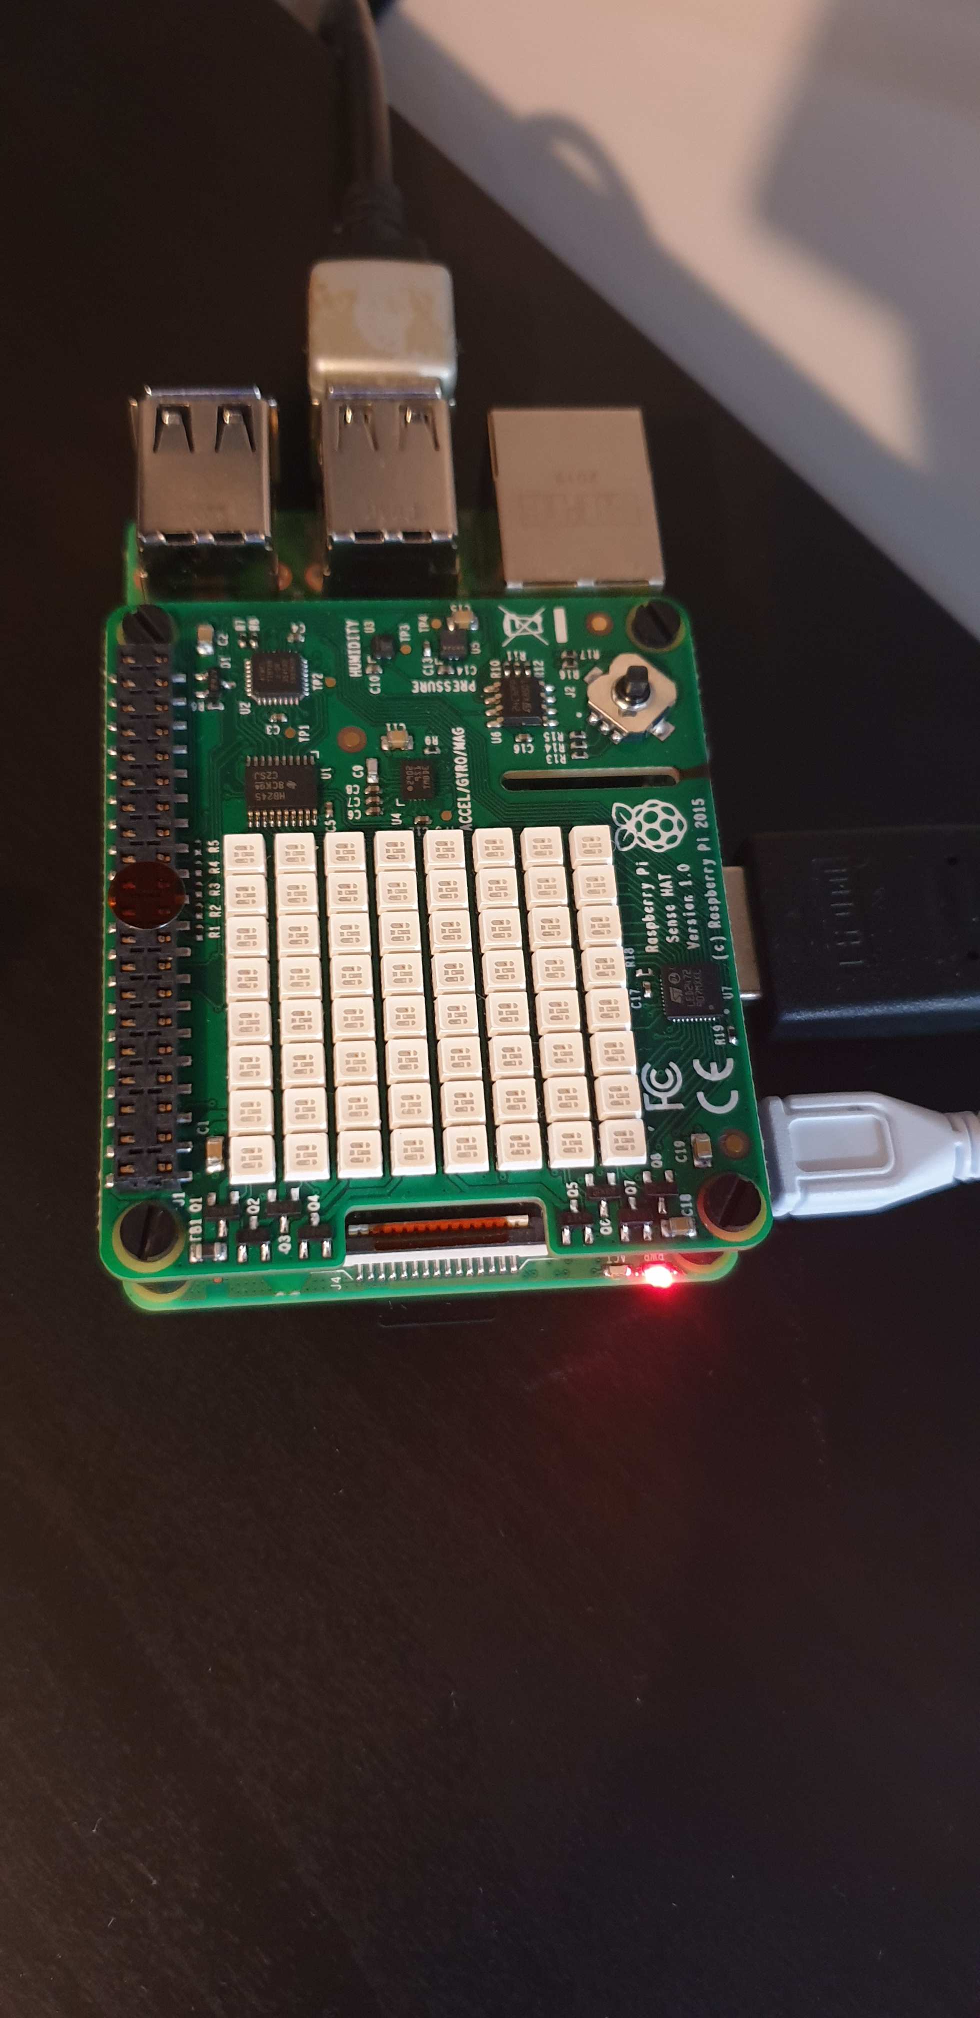
Components
Motion Sensor
Raspberry Pi

Slide 7


Components
BLYNK App
Python

Slide 8

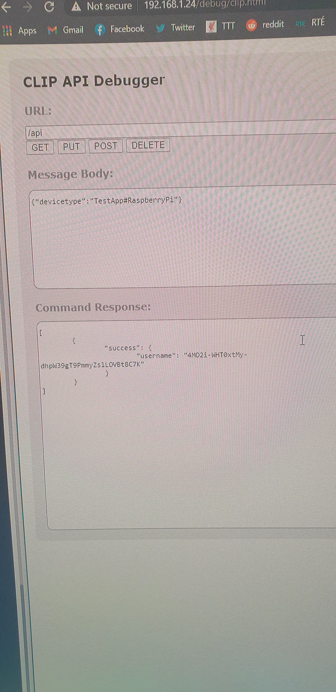
Resources
Philips Hue simple test web app built into every bridge
https://developers.meethue.com/develop/get-started-2/
Used to gain access to the Hue system
Raspberry Pi able to connect to this API using Python language And make changes to the lights using HTTP functions

Slide 9
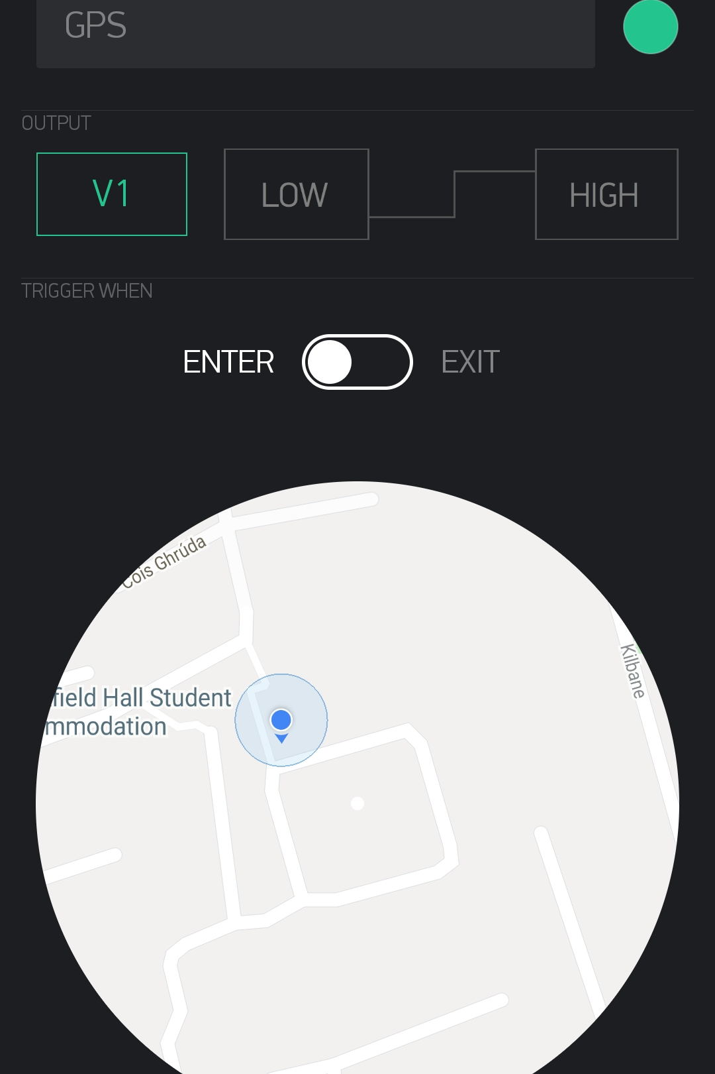
Resources
Blynk IOT platform
Used in this assignment to turn on the lights via a GPS trigger.
Location is pictured to the right where upon entry to this section of the map the lights will turn on

Slide 10
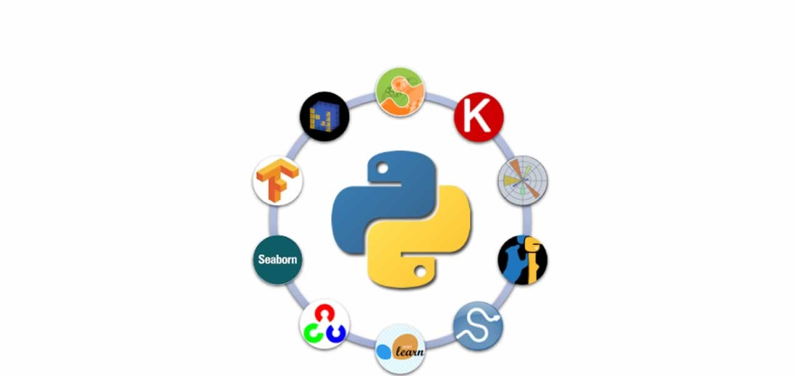
Resources
Librarys used
import blynklib #used to connect the pi to the blynk app. Blynk app will have a gps trigger
from phue import Bridge #Philips hue library and importing the bridge component for communicating with the pi
from datetime import datetime #for use in getting current time
from suntime import Sun, SunTimeException # library for calculating sunset/sunrise times
import pytz # used to make sure both timezones are in the correct timezone
import requests #used to make a request to a web page and print the response text
import json #used to work with json data
import time #used for keeping stuff running
import logging
logging.basicConfig()

Slide 11
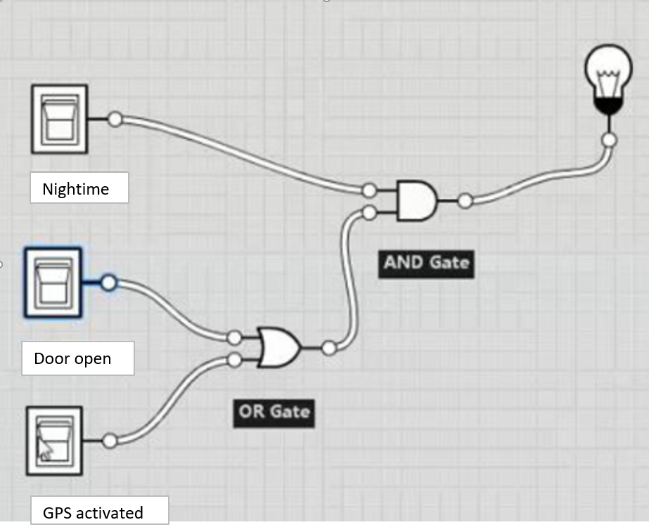
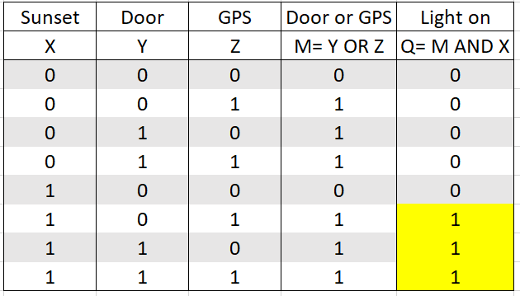
Algorithm Logic
Logic gate
Truth Table

